Slide 1
Island Biogeography
Speciation
Biological Invasions
AG/BI 345 Lecture
9-Dec-2003
by Aubrey Moore
Updated for EV510, Aug. 23, 2012

Slide 2
Introduction
Island populations inspired the formation of the theory of evolution:
Charles Darwin: voyage of the Beagle; Galapagos Islands
Alfred Russell Wallace: Indonesia

Slide 3
Introduction
Islands are important to entomology:
Evolutionary biology of Drosophila in the Hawaiian Islands
Eradication of screw worm flies from Curacao using the sterile insect releases (SIR)
Eradication of melon fly from Rota using SIR, and oriental fruit fly using male annihilation.

Slide 4
Introduction
Types of Islands:
Oceanic islands
Continental islands
Sky islands
"Islands within islands": kipukas on the Big Island of Hawaii
Parks and wildlife refuges

Slide 5
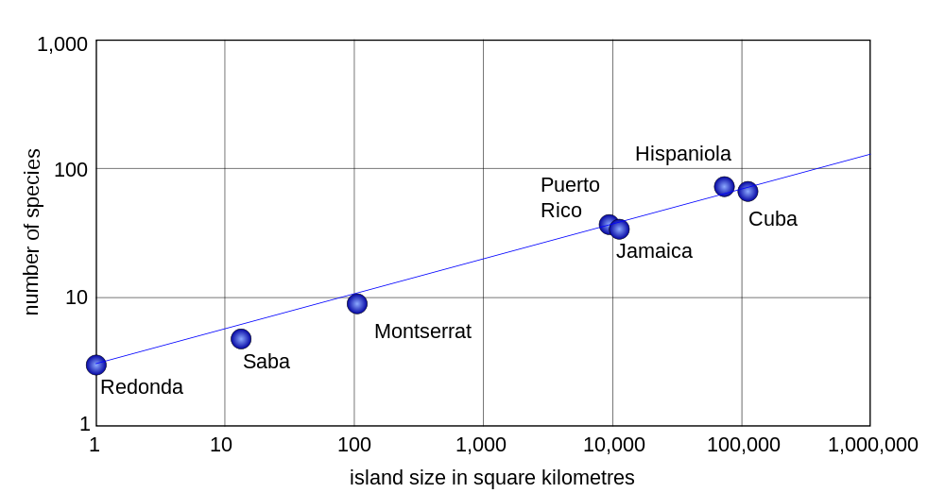
Island Biogeography
Size Matters: Area-Species Curves
Area-species curve for West Indian herpetofauna (reptiles and amphibians) from Darlington (1957)
"Division of area by 10, going from island to island, divides the fauna by 2."

Slide 6
Colonization by New Species
Immigration of New Species
Rate(species/year)
No. of Species Present

Slide 7
Loss of species by local extinction
Species Extinction
Rate(species/year)
No. of Species Present

Slide 8
No. of species is an equilibrium where colonization rate equals extinction rate
Equilibrium
Rate(species/year)
No. of Species Present

Slide 9
Extinction Rate for Small Islands is High
Species Extinction
Rate(species/year)
No. of Species Present

Slide 10
Extinction Rate for Large Islands is Low
Species Extinction
Rate(species/year)
No. of Species Present

Slide 11
Immigration Rate for Near Islands is High
Immigration of New Species
Rate(species/year)
No. of Species Present

Slide 12
Immigration Rate for Far Islands is Low
Immigration of New Species
Rate(species/year)
No. of Species Present

Slide 13
MacArthur & Wilson Equilibrium Model
Rate(species/year)
Near
Small
Far
Large
No. of Species Present

Slide 14
The MacArthur and Wilson equilibrium model has been expressed mathematically.
The mathematical model can predict:
- number of species (at equilibrium)
- time to equilibrium
- turnover (rate at which species are replaced by other species)

Slide 15
Empiracle Test of the MacArthur-Wilson Theory of Island Biogeography:
Establishment of Avifauna on Anak Krakatau
 | Predicted | Observed
Species count | 30 | 27
Years to equilibrium | 40 | ~40
Species turnover | 1 per year | 0.38

Slide 16
Speciation
Species Definition:
Groups of populations which can potentially interbreed or are actually interbreeding, that can successfully produce viable, fertile offspring (without the help of human technology). [Ernst Mayr, 1969]
The species is the most fundamental unit of evolution and is the most specific level.

Slide 17
Speciation
Many cases of natural selection have been observed: industrial melanism, insecticide resistance, etc. (microevolution)
However, evolution of a new species (macroevolution) has not been observed. Evidence of speciation can be found from the fossil record, and from genetic studies.

Slide 18
Speciation
Rate of speciation on islands is believed to be very high.
Many island insects are endemic: they evolved as new species from immigrants and are found nowhere else. Endemicity for insects on the Hawaiian Islands is about 90%; Endemicity for the Mariana Islands is about 45% (Gressitt, 1954).

Slide 19
Speciation
Factors Contributing to High Speciation Rate on Islands:
Geographical isolation
Genetic drift (random changes)
Adaptation to island environments (evolution of flightless birds & insects is common on islands)
Founder effects (low genetic diversity; evolutionary bottlenecks)

Slide 20
Biological Invasions
Invasive Species Criteria
Alien (exotic)
Causes economic, ecological, or environmental damage

Slide 21
Biological Invasions
Invasion rate increased rapidly during the last 50 years. Most significant increase due to movement of people and goods by jet aircraft.
Currently, about 15 new pest insects are detected in Hawaii each year
Rate for the Mariana Islands is about 1 or 2 new pest insects per year.

Slide 22
Biological Invasions
Invasion rate increased rapidly during the last 50 years. Most significant increase due to movement of people and goods by jet aircraft.
Currently, about 15 new pest insects are detected in Hawaii each year
Rate for the Mariana Islands is about 1 or 2 new pest insects per year.

Slide 23
Biological Invasions
Island ecosystems are very susceptible to damage by invasive species because:
Natural controls such as parasites, predators, and cold weather are not present – "Escape from natural enemies."
Failure of quarantine systems and lack of funds or expertise for effective rapid response

